Slide 1

AI-Powered Python in Excel
George Mount
Stringfest Analytics

Slide 2
Objectives for today
Master Python in Excel for enhanced data analysis with Copilot.
Automate PivotTables and data summaries using Python in Excel.
Create advanced visualizations with Python libraries in Excel.
Build basic predictive models with Python for Excel trend analysis.
Manage and analyze time series data in Excel using Python.
Process text data in Excel with Python for sentiment and keywords.
Validate Python and AI results in Excel for accuracy.

Slide 3
Schedule for today
Module 1: Excel essentials for AI
Module 2: Introduction to Copilot in Excel
Module 3: Data visualization and PivotTables
Module 4: Time series and Text Analysis

Slide 4

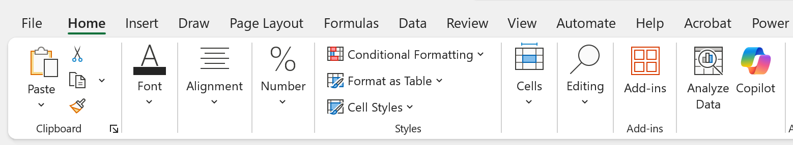
Pulse Check
Do you have access to Copilot in Excel?
Home > Copilot

Slide 5
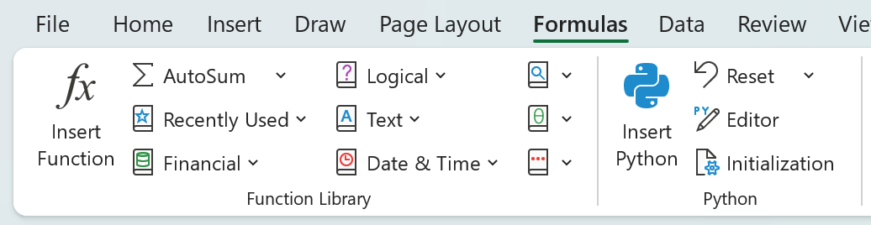
Pulse Check
Do you have access to Python in Excel?
Formulas > Python

Slide 6
I. Excel essentials for AI
Less is more. Keep your bullet points and graphics simple and clear. Bold important terms and animate bullet points to help attendees follow your presentation
Too much information for one slide? Break it out into multiple slides.
Real-world examples and case studies help learners contextualize and retain new information.

Slide 7
Exercise
If you screen share during your exercise attendees will still be able to see the slide deck. Including some brief instructions or information to reference during the exercise can be helpful.
Step one
Step two
Profit!

Slide 8
Questions?
Notes:
You will be able to see questions as they come in. Some instructors like to include this slide as a visual reminder to check the Q&A widget, but it’s not required.

Slide 9
II. Introduction to Copilot in Excel
Less is more. Keep your bullet points and graphics simple and clear. Bold important terms and animate bullet points to help attendees follow your presentation
Too much information for one slide? Break it out into multiple slides.
Real-world examples and case studies help learners contextualize and retain new information.

Slide 10
Discussion Question
Identify a routine task that you believe could be automated or assisted using Copilot. How would this change your workflow?

Slide 11
Poll: What will you ask attendees?
Polls are a great way to check in with attendees! You can ask them about their opinions, experience level, or quiz their knowledge. We find that 1-3 poll questions per hour is best.
Poll answer 1
Poll answer 2
Poll answer 3

Slide 12
Questions?
Notes:
You will be able to see questions as they come in. Some instructors like to include this slide as a visual reminder to check the Q&A widget, but it’s not required.

Slide 13
IV. Time Series and Text Analysis
Less is more. Keep your bullet points and graphics simple and clear. Bold important terms and animate bullet points to help attendees follow your presentation
Too much information for one slide? Break it out into multiple slides.
Real-world examples and case studies help learners contextualize and retain new information.

Slide 14
Break
Notes:
Breaks are flexible in On24. At the end of your deck you’ll have 5 minute, 7 minute, 10 minute, and 15 minute timers that you will be able to push to the audience whenever you want. Some presenters like to include this break slide as a visual reminder, but it’s not required.

Slide 15
Discussion Question
What should attendees think about? Ask a prompt question that attendees can answer in the group chat.

Slide 16
Questions?
Notes:
You will be able to see questions as they come in. Some instructors like to include this slide as a visual reminder to check the Q&A widget, but it’s not required.

Slide 17
V. Wrap-Up and Q&A
Less is more. Keep your bullet points and graphics simple and clear. Bold important terms and animate bullet points to help attendees follow your presentation
Too much information for one slide? Break it out into multiple slides.
Real-world examples and case studies help learners contextualize and retain new information.

Slide 18
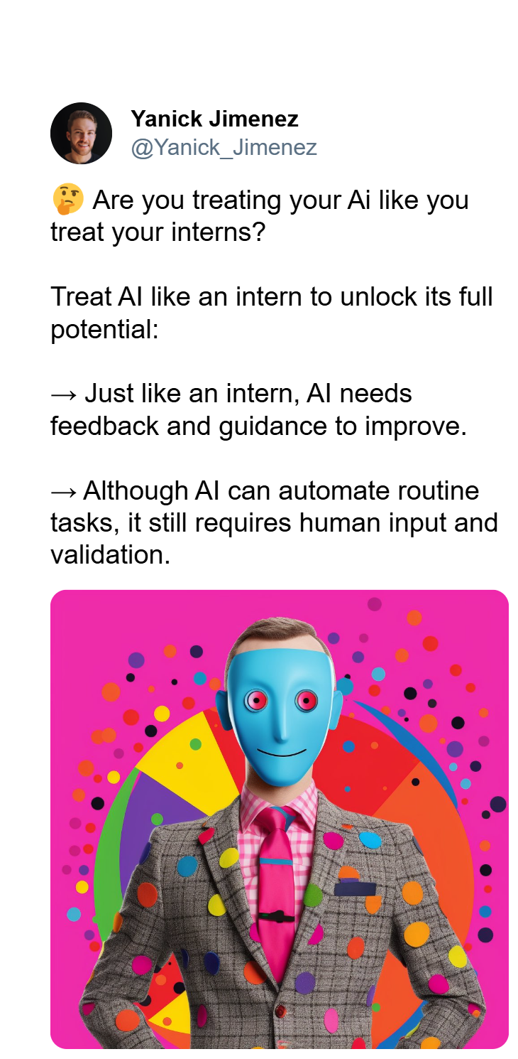
Cross-checking AI-powered Excel
What processes can we follow to safeguard and cross-check our Python-Copilot-Excel workflow?
Resource: https://stringfestanalytics.com/how-to-cross-check-ai-generated-insights-in-excel/
“Treat AI like an intern”

Slide 19
Q&A
Notes:
You will be able to see questions as they come in. Some instructors like to include this slide as a visual reminder to check the Q&A widget, but it’s not required.

Slide 20
Takeaways
Resources for further learning
Read Python for Excel: A Modern Environment for Automation and Data Analysis (book)
Attend Write Python Code with ChatGPT and Claude (live online course by Trey Hunner)
Attend Generative AI Essentials with ChatGPT, Copilot, and Gemini (live online course by Aamir Lakhani)

Slide 21
Takeaways
Get in touch
stringfestanalytics.com: Subscribe for more content and updates
linkedin.com/in/gjmount: Follow for all things analytics in modern Excel

Slide 22
Takeaways
Next steps
A quick survey will appear on your screen soon… we’d love to hear your thoughts
You’ll receive a recording via email within 24-48 hours.
Thanks so much for joining -- hope to see you at future events!

Slide 23


